Slide 1
Oracle SQL Tuning & Optimizer ( Part 2) – Execution Plan
Zhaoping Lu
2016.09

Slide 2
About
The target audiences of this training are people who have the basic SQL knowledge.
This training intend to introduce the knowledge about Oracle SQL itself.

Slide 3
Agenda
Execution Plan
How to get execution plan
How read execution plan
Understand OPERATION in execution plan
Join Methods
Join Types

Slide 4
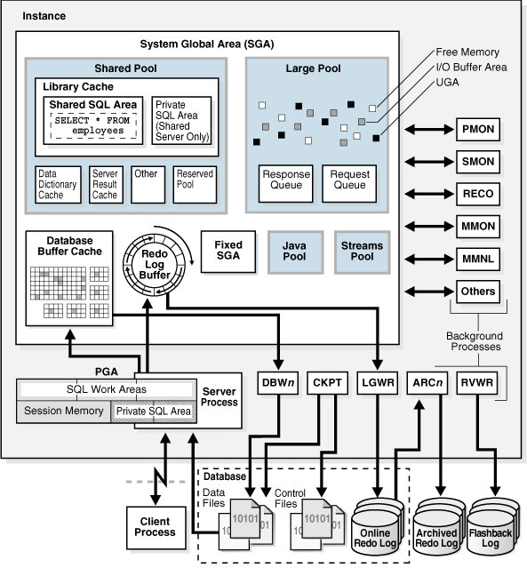
Oracle Database Architecture
Database
Data Files
Control Files
Redo Files
Instance
PGA
SQL Work Area
Private SQL Area
SGA
Shared Pool
Library Cache

Slide 5
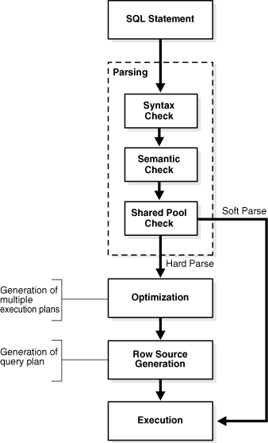
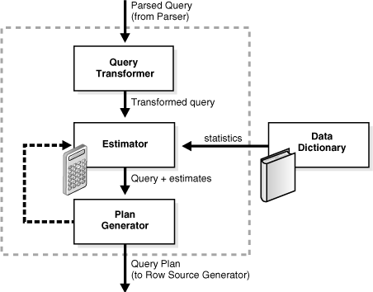
Overview of SQL Processing
Parsing
Optimization
Query Transformation
Estimation
Generating Execution Plan
Execution
Notes:
Read more:
http://docs.oracle.com/database/121/TGSQL/tgsql_sqlproc.htm#TGSQL176
https://jonathanlewis.wordpress.com/explain-plan/

Slide 6
How to get execution plan
Generate | Display | Source/Remarks
Explain plan for … Set autotrace on/trace F10 in Sql Developer | Dbms_xplan.display_plan | Plan_table/ Most conventional way May get unreal plan if there are bind variables
Execute sql directly Hint gather_plan_statistics | Dbms_xplan.display_cursor | Memory - Library Cache/ Most solid & convenient way
AWR Snapshot | Dbms_xplan.display_awr | AWR Repo/ Useful for post analysis
Hint monitor Parameter _sqlmon_threshold Parameter statistics_level=all | Dbms_sqltune.report_sql_monitor | SGA - library cache/ More plan stats
Notes:
alter session set statistics_level=all;
select count(*) from dual connect by level <123456789
statistics_level=all format:
Plan hash value: 968211682
--------------------------------------------------------------------------------------------------------------
| Id | Operation | Name | Starts | E-Rows | Cost (%CPU)| E-Time | A-Rows | A-Time |
--------------------------------------------------------------------------------------------------------------
| 0 | SELECT STATEMENT | | 1 | | 2 (100)| | 0 |00:00:00.01 |
| 1 | SORT AGGREGATE | | 1 | 1 | | | 0 |00:00:00.01 |
| 2 | CONNECT BY WITHOUT FILTERING| | 1 | | | | 45M|00:00:13.56 |
| 3 | FAST DUAL | | 1 | 1 | 2 (0)| 00:00:01 | 1 |00:00:00.01 |
--------------------------------------------------------------------------------------------------------------
Monitor format:
Global Stats
========================================
| Elapsed | Cpu | Other | Fetch |
| Time(s) | Time(s) | Waits(s) | Calls |
========================================
| 16 | 16 | 0.06 | 1 |
========================================
SQL Plan Monitoring Details (Plan Hash Value=968211682)
=====================================================================================================================================
| Id | Operation | Name | Rows | Cost | Time | Start | Execs | Rows | Activity | Activity Detail |
| | | | (Estim) | | Active(s) | Active | | (Actual) | (%) | (# samples) |
=====================================================================================================================================
| 0 | SELECT STATEMENT | | | | 11 | +6 | 1 | 0 | | |
| 1 | SORT AGGREGATE | | 1 | | 11 | +6 | 1 | 0 | 20.00 | Cpu (3) |
| 2 | CONNECT BY WITHOUT FILTERING | | | | 16 | +1 | 1 | 46M | 80.00 | Cpu (12) |
| 3 | FAST DUAL | | 1 | 2 | 1 | +6 | 1 | 1 | | |
=====================================================================================================================================

Slide 7
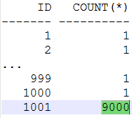
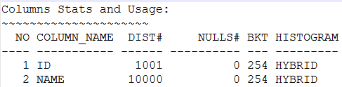
Prepare The Demo Table
create table test1 as
select case when rownum>1000 then 1001 else rownum end id, table_name name
from all_tables where rownum<=10000;
create index test1_id on test1(id);
create table test2 as select * from test1 where rownum<=1000;
create index test2_id on test2(id);
create index test2_name on test2(name);
create table test3 as select id ,id-1 parent_id,name from test1;
create index test3_id on test3(id);
create index test3_parentid on test3(parent_id);
select id,count(*) from test1 group by id;
exec dbms_stats.gather_table_stats(user,'TEST1',METHOD_OPT=>'FOR ALL COLUMNS SIZE 254');
Notes:
drop table test1;
create table test1 as select case when rownum>1000 then 1001 else rownum end id, table_name name from all_tables where rownum<=10000;
create index test1_id on test1(id);
exec dbms_stats.gather_table_stats(user,'TEST1',METHOD_OPT=>'FOR ALL COLUMNS SIZE 254');
drop table test2;
create table test2 as select * from test1 where rownum<=1000;
create index test2_id on test2(id);
exec dbms_stats.gather_table_stats(user,'TEST2',METHOD_OPT=>'FOR ALL COLUMNS SIZE 254');

Slide 8
Get execution plan by “explain plan”
 | Cases | Remarks
1 | explain plan for select /*+ sample_sql1 */ max(name) from test1 where id=1; select plan_table_output from table(dbms_xplan.display('plan_table',null,'serial')); (Or @?/rdbms/admin/utlxpls)
2 | SET AUTOT[RACE] {OFF|ON|TRACE[ONLY]} [EXP[LAIN]] [STAT[ISTICS]] Set autot trace select /*+ sample_sql1 */ max(name) from test1 where id=1; | We can skip the output of result Only Show stats
3 | F10 in Sql Developer | Nice format, easy to read
Note: ‘Explain plan for …’ may get unreal plan if there are bind variables in SQL. Like this:
select /*+ sample_sql1 */ max(name) from test1 where id=:myid;
Notes:
-- display plan in plan_table
col op for a50
col obj for a30
col part for a10
col COST for 999,999,999
col ACCESS_PREDICATES for a30
col par for 999
with tmp as (
select id,parent_id,operation,options,object_name,object_owner,
optimizer,cost,io_cost,cardinality,bytes,cpu_cost,temp_space
,partition_start,partition_stop,partition_id,to_char(timestamp,'mmdd hh24:mi:ss') ts,substr(access_predicates,1,60) access_predicates
from plan_table order by id
)
select id, parent_id par,
lpad(' ',(level-1)*2,' ')||operation || ' ' || options op,
decode(object_name,null,null,object_owner || '.' || object_name||decode(optimizer,null,' ','('||optimizer||')')) obj,--access_predicates,
cost, io_cost, cardinality card, bytes,cpu_cost, temp_space,
partition_start || '~' || partition_stop part, partition_id partid--,ts
from tmp
connect by prior id=parent_id
start with id=0
;

Slide 9
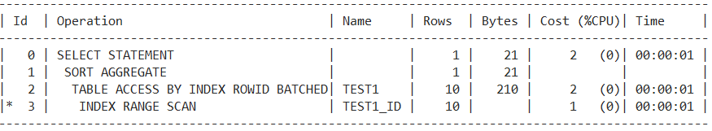
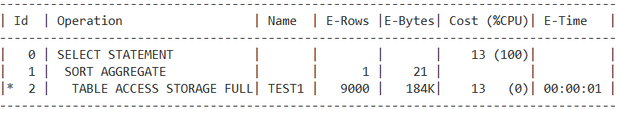
‘Explain plan for …’ may get unreal plan if there are bind variables in SQL
var myid number;
exec :myid:=1001;
set autot trace
select /*+ sample_sql1 */ max(name) from test1 where id=:myid;
While the real execution plan is:
Notes:
Read more:
http://allthingsoracle.com/execution-plans-part-1-finding-plans/

Slide 10
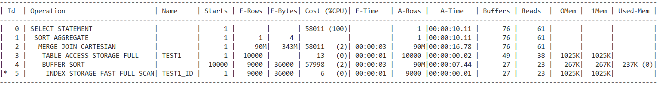
Get execution plan from Memory – Library Cache
Sample:
select /*+ sample_sql1 */ max(name) from test1 where id=:myid;
select /*+ sample_sql1 gather_plan_statistics */ count(*) from test1 t1,test1 t2 where t2.id=:myid;
select sql_id,sql_fulltext from v$sql s where instr( lower(s.SQL_FULLTEXT) ,lower(' sample_sql1')) > '0';
select * from table(dbms_xplan.display_cursor('&sqlid', null, 'ADVANCED ALLSTATS LAST'));
Note: This way will always get the real execution plan.
Hint: gather_plan_statistics
Or statistics_level=ALL (default: TYPICAL)
Notes:
var myid number;
exec :myid:=1;
select max(name) from test1 where id=:myid;
Read more: https://jonathanlewis.wordpress.com/2016/05/11/dbms_xplan/

Slide 11
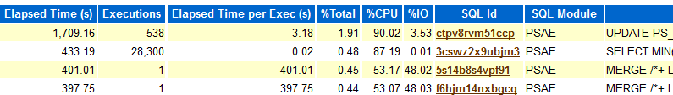
Get execution plan from AWR Repository
Sample:
select dbms_workload_repository.create_snapshot() from dual;
exec :myid:=1001;
Select count(*) from test1 t1,test1 t2 where t2.id=:myid;
select dbms_workload_repository.create_snapshot() from dual;
@?/rdbms/admin/awrrpt
select * from table(dbms_xplan.display_awr('&sqlid');
(or: @?/rdbms/admin/awrsqrpt)
Notes:
Execution plan missed in awr sql report in 12.1
Ref: BUG 24626166 - EXECUTION PLAN INFORMATION IS MISSING IN AWR SQL REPORT GENERATED IN CDB

Slide 12
Get execution plan for monitored SQL
SQL is monitored if (So the execution plan statistics will be saved):
SQL elapsed time > 5s (default, specified by parameter _sqlmon_threshold)
SQL with hint monitor
Parameter statistics_level=ALL (default: TYPICAL)
Sample:
var myid number;
exec :myid:=1001;
select /*+ sample_sql1 monitor */ count(*) from test1 t1,test1 t2 where t2.id=:myid;
select /*+ sample_sql1 */ count(*) from test1 t1,test1 t2,(select * from test1 where rownum<5);
select sql_id,sql_fulltext from v$sql s where instr( lower(s.SQL_FULLTEXT) ,lower(' sample_sql1')) > '0';
select DBMS_SQLTUNE.REPORT_SQL_MONITOR('&sqlid',report_level=>'ALL', type=>'text') from dual;
Notes:
Read more: http://allthingsoracle.com/execution-plans-part-14-sql-monitoring/

Slide 13
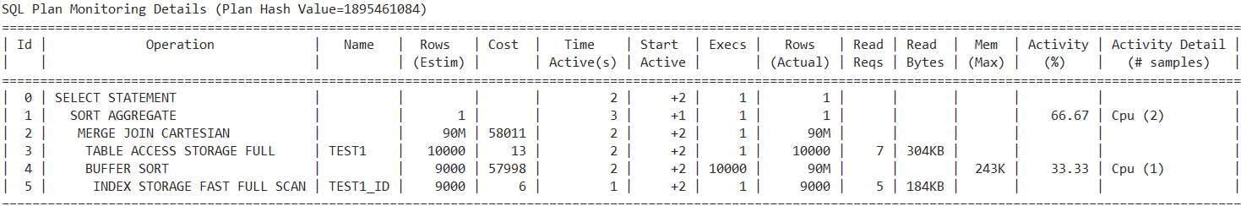
Get execution plan from SQL Monitor – cont’d
select /*+ sample_sql1 monitor */ count(*) from test1 t1,test1 t2 where t2.id=:myid;
select DBMS_SQLTUNE.REPORT_SQL_MONITOR('&sqlid',report_level=>'ALL', type=>'text') from dual;
Notes:
Ref: http://docs.oracle.com/database/121/ARPLS/d_sqltun.htm#ARPLS68444

Slide 14
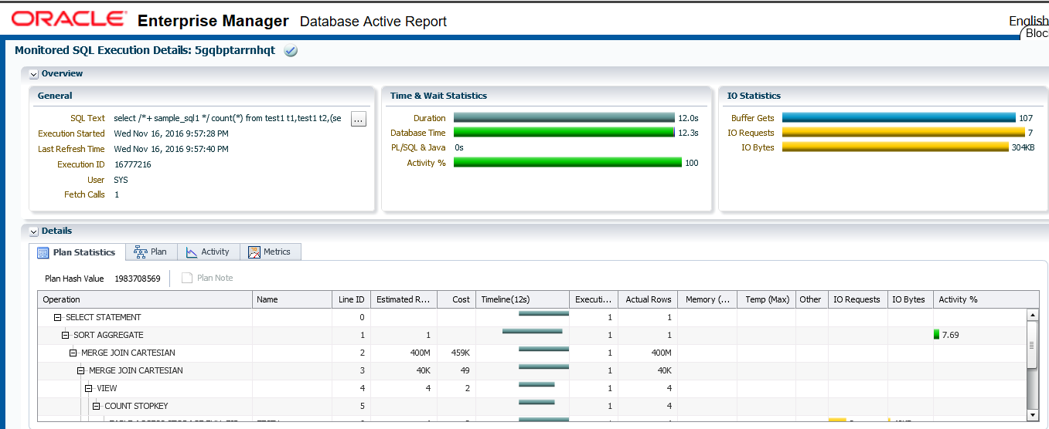
Get execution plan from SQL Monitor – cont’d 2
select /*+ sample_sql1 */ count(*) from test1 t1,test1 t2,(select * from test1 where rownum<5);
select DBMS_SQLTUNE.REPORT_SQL_MONITOR('&sqlid',report_level=>'ALL', type=>‘active') from dual;
Notes:
Ref: http://docs.oracle.com/database/121/ARPLS/d_sqltun.htm#ARPLS68444
Note: If firefox can not display sql monitor active report, try IE or Edge. Or uncomment the commented lines in the head of html file.
-- Full script to generate html type report:
set echo off verify off timing off trimsp on feed off pages 0 term off long 9999999 longc 9999999
--optional: disable compress in report
alter session set events 'emx_control compress_xml=none';
spool sqlmon_active_report.html
select DBMS_SQLTUNE.REPORT_SQL_MONITOR('&sqlid',report_level=>'ALL',type=>'ACTIVE') rep from dual;
spool off

Slide 15
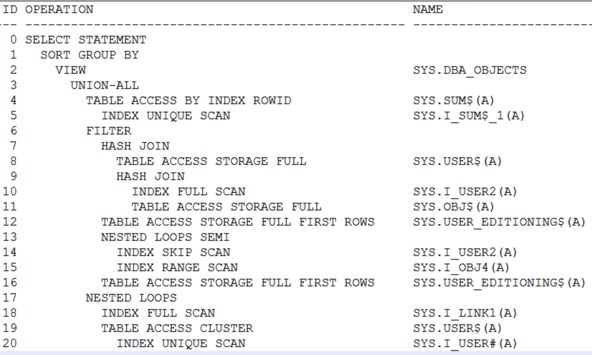
How to read execution Plan
Sometimes, the hardest part is to find out the executing sequence of execution plan. For example:
Notes:
explain plan for select owner, object_type, count(*) from dba_objects group by owner, object_type order by owner, object_type;

Slide 16
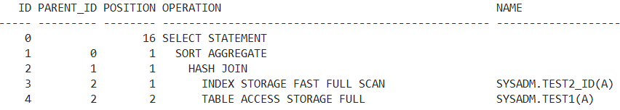
With id/parent_id/position
ID: A number assigned to each step in the execution plan
PARENT_ID: ID of the next execution step that operates on the output of the current step
POSITION: Order of processing for all operations that have the same PARENT_ID

Slide 17
With id/parent_id/position – Sample 1
ID 0 has a child 1, so need to run ID 1 before ID 0
ID 1 has child 2, so need to run ID 2 before ID 1
ID 2 has 2 children (3,4), so need to run ID 3 and before ID 2
ID 3 and 4 have same parent ID (2). Which one be run firstly?
Decided by POSITION number.
ID PARENT_ID POSITION OPERATION -- --------- -------- ---------------------------------- 0 16 SELECT STATEMENT 1 0 1 SORT AGGREGATE 2 1 1 HASH JOIN 3 2 1 INDEX STORAGE FAST FULL SCAN 4 2 2 TABLE ACCESS STORAGE FULL

Slide 18
With id/parent_id/position – Sample 2
ID 3,7 have same PARENT_ID 2.
ID 3 will be run firstly because of the smaller POOSITION value.
ID 4,6 have same PARENT_ID 3.
ID 4 will be run firstly because of the smaller POOSITION value.
ID PARENT_ID POSITION OPERATION -- --------- -------- ------------------------------------------- 0 6 SELECT STATEMENT 1 0 1 SORT AGGREGATE 2 1 1 HASH JOIN 3 2 1 NESTED LOOPS 4 3 1 TABLE ACCESS BY INDEX ROWID BATCHED 5 4 1 INDEX RANGE SCAN 6 3 2 INDEX RANGE SCAN 7 2 2 INDEX STORAGE FAST FULL SCAN

Slide 19
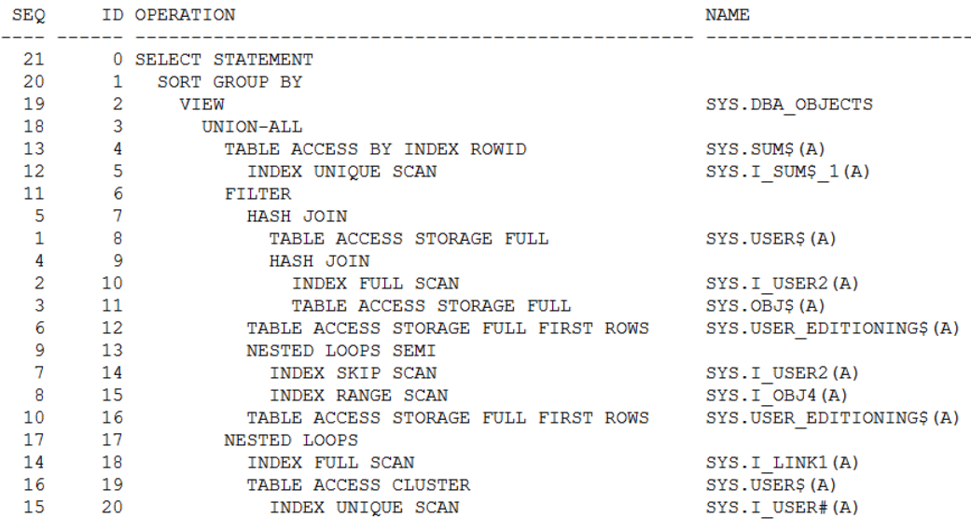
Calculate the sequence by id/parent_id/position
Note: SQL in note zone.
Notes:
--Execution plan with sequence from plan_table:
-- seq limitation: the total lines of execution plan < 1000
select
row_number() over (partition by 1 order by rpad(sys_connect_by_path(nvl2(parent_id,999-position,'999')||'-'||(999-id),'/'),8000,' ') desc) seq,
id, lpad(' ',(level-1)*2,' ')||operation || ' ' || options operation,
decode(object_name,null,null,object_owner || '.' || object_name||decode(optimizer,'ANALYZED','(A)',null,' ','('||optimizer||')')) name,
cost, io_cost, cardinality card, bytes,cpu_cost
from plan_table
connect by prior id=parent_id
start with id=0
order by id
;
with tmp as (select * from v$sql_plan where sql_id='&1')
select
row_number() over (partition by 1 order by rpad(sys_connect_by_path(nvl2(parent_id,999-position,'999')||'-'||(999-id),'/'),8000,' ') desc) seq,
id, lpad(' ',(level-1)*2,' ')||operation || ' ' || options operation,
decode(object_name,null,null,object_owner || '.' || object_name||decode(optimizer,'ANALYZED','(A)',null,' ','('||optimizer||')')) obj,
cost, io_cost, cardinality card, bytes,cpu_cost
from tmp
connect by prior id=parent_id
start with id=0
order by id
;

Slide 20
What if the execution plan was given without sequence or even parent_id/position
Rules help to read execution plan in right sequence – find the first line which will be executed
Rule 1: The 1st row source of the join operation will be executed firstly.
The join operation need 2 row sources to complete the operation.
Rule 2: Follow the Rule 1 and then, the innermost indented line is the first statement executed
Rule 3: Follow the Rule 2 and then, the lines under the same parent with same indent level will be executed in sequence.
Rule 4: Follow the Rule 3 unless the rowsources depend on other rowsources.
Rule 5: Some exceptions …
Notes:
Ref: http://docs.oracle.com/database/121/TGSQL/tgsql_interp.htm#TGSQL277

Slide 21
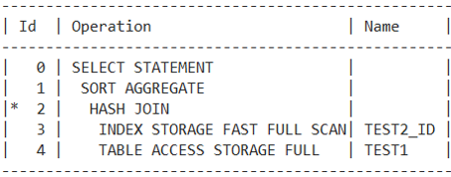
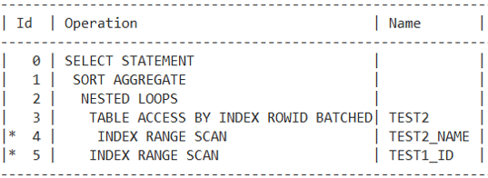
Rule 1: The 1st row source of the join operation will be executed firstly.
The join operation need 2 row sources to complete the operation.
Nested loop / Hash join / Merge join / Cartesian join
Samples:
Seq: 3,4,2,1,0
Seq: 4,3,5,2,1,0
Notes:
select max(t1.name) from test1 t1,test2 t2 where t1.id=t2.id;
select count(*) from test1 t1,test2 t2 where t1.id=t2.id and t2.name='asdf';

Slide 22
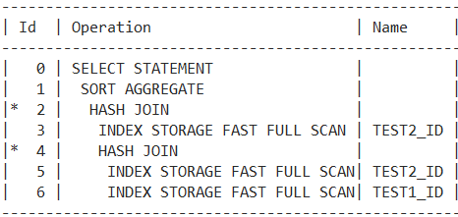
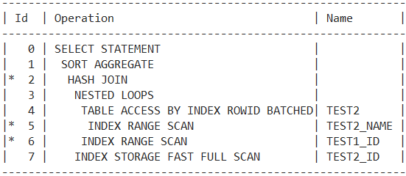
Rule 2: Follow the Rule 1 and then, the innermost indented line is the first statement executed
Samples:
Seq: 3,5,6,4,2,1,0
Seq: 5,4,6,3,7,2,1,0
Notes:
select count(*) from test1 t1,test2 t2,test2 t3 where t1.id=t3.id and t1.id=t2.id;
select count(*) from test1 t1,test2 t2,test2 t3 where t1.id=t3.id and t1.id=t2.id and t2.name='asdf';

Slide 23
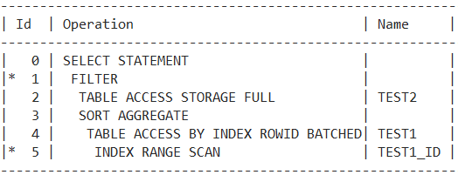
Rule 3: Follow the Rule 2 and then, the lines under the same parent with same indent level will be executed in sequence.
Samples:
Seq: 2,5,4,3,1,0
Notes:
select * from test2 t2 where t2.name = (select max(name) from test1 t1 where t1.id=t2.id);

Slide 24
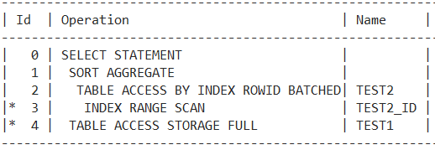
Rule 4: Follow the Rule 3 unless the rowsources depend on other rowsources.
Sample:
Seq: 4,3,2,1,0
Notes:
select
case when (t1.name =(select max(name) from test2 t2 where t2.id=t1.id)) then 111 else 222 end col1
from test1 t1 where t1.name='asdf';

Slide 25
Special execution plan – Bloom Filter/Join Filter Create and use
SEQ ID PAR POSITION OPERATION OBJ ---- ------ ---- -------- --------------------------------------------- ----------------- 11 0 17 SELECT STATEMENT 10 1 0 1 HASH JOIN SEMI 7 2 1 1 JOIN FILTER CREATE SYS.:BF0000 6 3 2 1 NESTED LOOPS 4 4 3 1 NESTED LOOPS 2 5 4 1 TABLE ACCESS BY INDEX ROWID BATCHED SYSADM.TEST2 1 6 5 1 INDEX RANGE SCAN SYSADM.TEST2_NAME 3 7 4 2 INDEX RANGE SCAN SYSADM.TEST1_ID 5 8 3 2 TABLE ACCESS BY INDEX ROWID SYSADM.TEST1 9 9 1 2 JOIN FILTER USE SYS.:BF0000 8 10 9 1 TABLE ACCESS STORAGE FULL SYSADM.TEST1
Notes:
--Bloom filter/JOIN FILTER CREATE
select t1.*
from test1 t1,test2 t2
where t1.id=t2.id
and t2.name='asdf'
and exists (select 1 from test1 t4 where t4.id=t1.id and t4.name <'aaa');
Predicate Information (identified by operation id):
---------------------------------------------------
10 - storage(("T4"."NAME"<'aaa' AND SYS_OP_BLOOM_FILTER(:BF0000,"T4"."ID")))
filter(("T4"."NAME"<'aaa' AND SYS_OP_BLOOM_FILTER(:BF0000,"T4"."ID")))
When two tables are joined via a hash join, the first table (typically the smaller table) is scanned and the rows that satisfy the WHERE clause predicates (for that table) are used to create a hash table. During the hash table creation, a Bloom filter bit string is also created based on the join column. The bit string is then sent as an additional predicate to the second table scan. After the WHERE clause predicates relating to the second table are applied, the resulting rows are tested using the Bloom filter. Any rows rejected by the Bloom filter must fail the join criteria and are discarded. Any rows that match using the Bloom filter are sent to the hash join.

Slide 26
Special execution plan – Connect by
SEQ ID PAR POSITION OPERATION OBJ ---- ------ ---- -------- -------------------------------------------------- --------------------- 9 0 8 SELECT STATEMENT 8 1 0 1 FILTER 7 2 1 1 CONNECT BY WITH FILTERING 2 3 2 1 TABLE ACCESS BY INDEX ROWID BATCHED SYSADM.TEST3 1 4 3 1 INDEX RANGE SCAN SYSADM.TEST3_ID 6 5 2 2 NESTED LOOPS 3 6 5 1 CONNECT BY PUMP 5 7 5 2 TABLE ACCESS BY INDEX ROWID BATCHED SYSADM.TEST3 4 8 7 1 INDEX RANGE SCAN SYSADM.TEST3_PARENTID
Notes:
select /*+ CONNECT_BY_FILTERING */ level,t3.* from test3 t3 start with id=4 connect by prior id= parent_id;
Ref:
1. How to Understand Connect by Explain Plans on Oracle 10g Release 2 (Doc ID 729201.1)
The way connect by works is that it starts with a set of rows based on the start with clause, then it uses those rows in a connect by select to create the hierarchy.
2. http://docs.oracle.com/database/121/SQLRF/queries003.htm#SQLRF52332
Oracle processes hierarchical queries as follows:
A join, if present, is evaluated first, whether the join is specified in the FROM clause or with WHERE clause predicates.
The CONNECT BY condition is evaluated.
Any remaining WHERE clause predicates are evaluated.

Slide 27
Examine what we learned
| Id |Operation | Name ----------------------------------------------------------------------- | 0 |SELECT STATEMENT | | 1 | SORT GROUP BY | | 2 | VIEW | DBA_OBJECTS | 3 | UNION-ALL | |* 4 | TABLE ACCESS BY INDEX ROWID | SUM$ |* 5 | INDEX UNIQUE SCAN | I_SUM$_1 |* 6 | FILTER | |* 7 | HASH JOIN | | 8 | TABLE ACCESS STORAGE FULL | USER$ |* 9 | HASH JOIN | | 10 | INDEX FULL SCAN | I_USER2 |* 11 | TABLE ACCESS STORAGE FULL | OBJ$ |* 12 | TABLE ACCESS STORAGE FULL FIRST ROWS| USER_EDITIONING$ | 13 | NESTED LOOPS SEMI | |* 14 | INDEX SKIP SCAN | I_USER2 |* 15 | INDEX RANGE SCAN | I_OBJ4 |* 16 | TABLE ACCESS STORAGE FULL FIRST ROWS| USER_EDITIONING$ | 17 | NESTED LOOPS | | 18 | INDEX FULL SCAN | I_LINK1 | 19 | TABLE ACCESS CLUSTER | USER$ |* 20 | INDEX UNIQUE SCAN | I_USER#
Notes:
explain plan for select owner, object_type, count(*) from dba_objects group by owner, object_type order by owner, object_type;
SEQ ID PARENT_ID POSITION OPERATION NAME COST IO_COST CARD BYTES CPU_COST
---- ------ --------- -------- -------------------------------------------------- ------------------------------ ------------ ---------- ---------- ---------------- ----------
21 0 2,017 SELECT STATEMENT 2,017 1963 74 4,588 884040529
20 1 0 1 SORT GROUP BY 2,017 1963 74 4,588 884040529
19 2 1 1 VIEW SYS.DBA_OBJECTS 2,004 1963 232791 14,433,042 680565269
18 3 2 1 UNION-ALL
13 4 3 2 TABLE ACCESS BY INDEX ROWID SYS.SUM$(A) 0 0 1 26 1700
12 5 4 1 INDEX UNIQUE SCAN SYS.I_SUM$_1(A) 0 0 1 1050
11 6 3 1 FILTER
5 7 6 1 HASH JOIN 945 927 235658 32,285,146 299433019
1 8 7 1 TABLE ACCESS STORAGE FULL SYS.USER$(A) 3 3 73 1,314 40896
4 9 7 2 HASH JOIN 941 924 235658 28,043,302 275215373
2 10 9 1 INDEX FULL SCAN SYS.I_USER2(A) 1 1 73 1,752 7321
3 11 9 2 TABLE ACCESS STORAGE FULL SYS.OBJ$(A) 938 923 235658 22,387,510 251031302
6 12 6 2 TABLE ACCESS STORAGE FULL FIRST ROWS SYS.USER_EDITIONING$(A) 2 2 1 6 7611
9 13 6 3 NESTED LOOPS SEMI 3 3 1 31 22614
7 14 13 1 INDEX SKIP SCAN SYS.I_USER2(A) 1 1 1 20 7321
8 15 13 2 INDEX RANGE SCAN SYS.I_OBJ4(A) 2 2 1 11 15293
10 16 6 4 TABLE ACCESS STORAGE FULL FIRST ROWS SYS.USER_EDITIONING$(A) 2 2 1 6 7611
17 17 3 3 NESTED LOOPS 1 1 1 31 8541
14 18 17 1 INDEX FULL SCAN SYS.I_LINK1(A) 0 0 1 13 200
16 19 17 2 TABLE ACCESS CLUSTER SYS.USER$(A) 1 1 1 18 8341
15 20 19 1 INDEX UNIQUE SCAN SYS.I_USER#(A) 0 0 1 1050

Slide 28
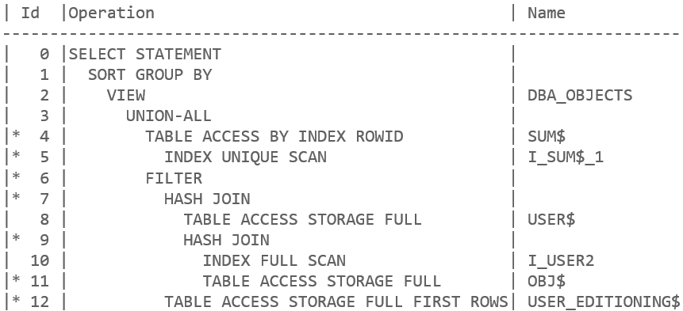
Understand OPERATION in execution plan
Table access
Index access
Join method

Slide 29
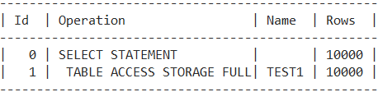
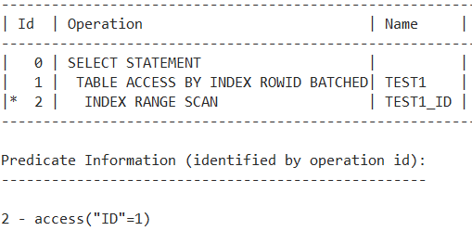
Table Access
Full
By index rowid

Slide 30
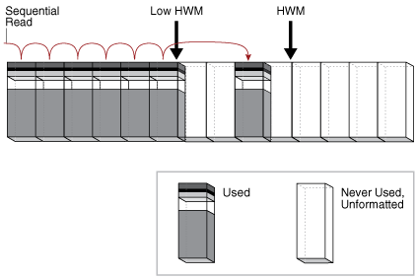
Table Access - Full
The database sequentially reads every formatted block under the high water mark.
Scan blocks with multiblock read.
Relevant parameters:
_db_file_exec_read_count = 128
_db_file_optimizer_read_count = 8
db_file_multiblock_read_count
Event:
db file scattered read
cell list of blocks physical read
cell multiblock physical read
Notes:
Ref:
https://docs.oracle.com/database/121/TGSQL/tgsql_optop.htm#TGSQL232
Relevant parameters:
_db_file_noncontig_mblock_read_count

Slide 31

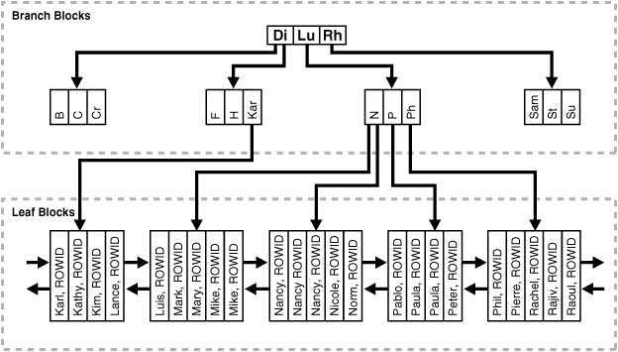
Rowid and Index
Rowid
Oracle Database uses a rowid to uniquely identify a row. Internally, the rowid is a structure that holds information that the database needs to access a row.
Index Leaf Block
The leaf blocks contain every indexed data value and a corresponding rowid used to locate the actual row. Each entry is sorted by (key, rowid). Within a leaf block, a key and rowid is linked to its left and right sibling entries.
Notes:
Ref:
http://docs.oracle.com/database/121/CNCPT/logical.htm#CNCPT1046

Slide 32
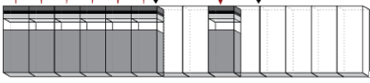
Table Access – By Index Rowid
Id | Operation | Name ------------------------------------------------ 0 | SELECT STATEMENT | 1 | TABLE ACCESS BY INDEX ROWID| PSOPRDEFN 2 | INDEX UNIQUE SCAN | PS_PSOPRDEFN
Sample:
Block Data
OPRID
Other Columns
I/O
KU1 …
VP1 …
KU2 …
KU3 …
PS1 …
TL1 …
Leaf
Index PS_PSOPRDEFN
SELECT emplid
FROM psoprdefn
WHERE oprid='VP1';
Branch
Root
VP1,rowid
I/O
I/O
I/O
Table PSOPRDEFN

Slide 33
Index Access
Unique scan
Range scan
Range scan (Min/Max)
Skip scan
Full scan
Fast full scan
…

Slide 34
Index Unique Scan
create unique index TEST1_ID_NAME on test1(id,name); select * from test1 where id=1 and name = 'aaa'; ---------------------------------------------------- | Id | Operation | Name | Rows | ---------------------------------------------------- | 0 | SELECT STATEMENT | | 1 | |* 1 | INDEX UNIQUE SCAN| TEST1_ID_NAME | 1 | ---------------------------------------------------- Predicate Information (identified by operation id): --------------------------------------------------- 1 - access("ID"=1 AND "NAME"='aaa') Statistics --------------------------------------------------- 2 consistent gets
Need B* Tree Unique Index
Need “=“ operator with all columns in a unique index
Seeking for at most 1 rowid then return
Better performance than ‘Index Range Scan’
less logical read

Slide 35
Index Range Scan
Need B* Tree Index
Work with many operator:
=, <=, <, >, >=, IN, BETWEEN, LIKE
Seeking for 0 thru many rowid
Scan Index Blocks with single I/O
Sometimes multiblock read if prefetch
Event:
db file sequential read
cell single block physical read
Relevant Parameters:
optimizer_index_caching = 0
optimizer_index_cost_adj = 100
_ignore_desc_in_index = FALSE
create index TEST1_ID_NAME on test1(id,name); select * from test1 where id=1 and name = 'aaa'; -------------------------------------------------- | Id | Operation | Name | Rows | -------------------------------------------------- | 0 | SELECT STATEMENT | | 1 | |* 1 | INDEX RANGE SCAN| TEST1_ID_NAME | 1 | -------------------------------------------------- Predicate Information (identified by operation id): --------------------------------------------------- 1 - access("ID"=1 AND "NAME"='aaa') Statistics --------------------------------------------------- 3 consistent gets
Notes:
Ref:
http://oracle-performance-tuning-tips2-dass.blogspot.jp/2010/10/oracle-tuning-tip12-index-range-scan.html
https://docs.oracle.com/cd/E58500_01/pt854pbh1/eng/pt/tadm/task_ConvertingDescendingIndexes.html#topofpage
Demo: Trace Consistent Read of ‘Index Range Scan’
create table test4 as select rownum id, 'name'||rownum name from dual connect by level <1000000;
insert into test4 select * from test4 where id <12349;
create index test4_id on test4(id);
alter session set events 'immediate trace name treedump level 350634'
alter session set events '10200 trace name context forever,level 1';
alter system set events 'sql_trace {process:orapid = 86} level 12'
-- index blocks:
branch: 0x5fc913b3 1607013299 (0: nrow: 4, level: 2)
branch: 0x5fcb16b6 1607145142 (-1: nrow: 672, level: 1)
leaf: 0x5fc913ef 1607013359 (25: row:449.449 avs:816)
branch: 0x5fcb195f 1607145823 (0: nrow: 670, level: 1)
branch: 0x5fcb1c0a 1607146506 (1: nrow: 670, level: 1)
branch: 0x5fcb1ce2 1607146722 (2: nrow: 214, level: 1)
-- return 2 rows
select * from test4 where id=12345;
-- CR trace:
WAIT #139963395496048: nam='Disk file operations I/O' ela= 29 FileOperation=8 fileno=0 filetype=8 obj#=653 tim=16862228065172
WAIT #139963395496048: nam='SQL*Net message to client' ela= 2 driver id=1650815232 #bytes=1 p3=0 obj#=653 tim=16862228065201
-- access index root block
ktrgtc2(): started for block <0x0004 : 0x5fc913b3> objd: 0x000559ab
ktrgtc2(): completed for block <0x0004 : 0x5fc913b3> objd: 0x000559ab
-- access index branch block
ktrgtc2(): started for block <0x0004 : 0x5fcb16b6> objd: 0x000559ab
ktrgtc2(): completed for block <0x0004 : 0x5fcb16b6> objd: 0x000559ab
-- access index leaf block for 1st rowid
ktrget2(): started for block <0x0004 : 0x5fc913ef> objd: 0x000559ab
ktrget2(): completed for block <0x0004 : 0x5fc913ef> objd: 0x000559ab
-- access table block for 1st row
ktrget2(): started for block <0x0004 : 0x5fc3624c> objd: 0x000559aa
ktrget2(): completed for block <0x0004 : 0x5fc3624c> objd: 0x000559aa
FETCH #139963395496048:c=0,e=324,p=0,cr=4,cu=0,mis=0,r=1,dep=0,og=1,plh=1674315994,tim=16862228065548
WAIT #139963395496048: nam='SQL*Net message from client' ela= 227 driver id=1650815232 #bytes=1 p3=0 obj#=653 tim=16862228065807
-- access index leaf block again for 2nd rowid
ktrget2(): started for block <0x0004 : 0x5fc913ef> objd: 0x000559ab
ktrget2(): completed for block <0x0004 : 0x5fc913ef> objd: 0x000559ab
-- access table block again for 2nd row
ktrget2(): started for block <0x0004 : 0x5fcb139e> objd: 0x000559aa
ktrget2(): completed for block <0x0004 : 0x5fcb139e> objd: 0x000559aa
WAIT #139963395496048: nam='SQL*Net message to client' ela= 1 driver id=1650815232 #bytes=1 p3=0 obj#=653 tim=16862228065959
FETCH #139963395496048:c=0,e=138,p=0,cr=2,cu=0,mis=0,r=1,dep=0,og=1,plh=1674315994,tim=16862228065970
STAT #139963395496048 id=1 cnt=2 pid=0 pos=1 obj=350634 op='TABLE ACCESS BY INDEX ROWID BATCHED TEST4 (cr=6 pr=0 pw=0 time=325 us cost=4 size=16 card=1)'
STAT #139963395496048 id=2 cnt=2 pid=1 pos=1 obj=350635 op='INDEX RANGE SCAN TEST4_ID (cr=4 pr=0 pw=0 time=292 us cost=3 size=0 card=1)'

Slide 36
Index Range scan (Min/Max)
Lots of XXXX SQL benefit from this operation.
SELECT * FROM PSTREENODE A WHERE A.EFFDT = (SELECT MAX(A_ED.EFFDT) FROM PSTREENODE A_ED WHERE A.SETID = A_ED.SETID AND A.SETCNTRLVALUE = A_ED.SETCNTRLVALUE AND A.TREE_NAME = A_ED.TREE_NAME AND A_ED.EFFDT <= SYSDATE); --------------------------------------------------------------- | Id | Operation | Name | Rows | --------------------------------------------------------------- | 0 | SELECT STATEMENT | | 1 | |* 1 | FILTER | | | | 2 | TABLE ACCESS STORAGE FULL | PSTREENODE | 11083 | | 3 | SORT AGGREGATE | | 1 | | 4 | FIRST ROW | | 1 | |* 5 | INDEX RANGE SCAN (MIN/MAX)| PS_PSTREENODE | 1 | ---------------------------------------------------------------
Notes:
Exception:
-- Optimizer can’t use ‘index range scan(min/max) if both max(), min() function appeared in select clause.
-- In this case, optimizer will use the regular ‘index range scan’
select
max(EFFDT)
,min(NODEEXP_IMAGE)
from pstreenode t
where tree_name='QUERY_TREE_EX'
and setid=' '
;

Slide 37
Index Range scan (Min/Max) vs. Index Range Scan
‘Index Range scan (Min/Max)’ is more efficient.
Need to put ‘effdt’ into the right position of index.
“SETID, SETCNTRLVALUE, TREE_NAME” in where clause
Max(EFFDT) in subquery
Index PS_PSTREENODE: (SETID, SETCNTRLVALUE, TREE_NAME, EFFDT, …)
Index Range Scan (Min/Max):
(2 Logical I/O )
…
1
Root/Branch
2
SETID=' '
SETCNTRLVALUE=' ' TREE_NAME='QUERY_TREE_EX'
…
…
Leaf Blocks
Index Range Scan:
(4 Logical I/O )
…
1
Root/Branch
2
4
3
SETID=' '
SETCNTRLVALUE=' ' TREE_NAME='QUERY_TREE_EX'
…
…
Leaf Blocks
Notes:
select max(effdt)
from pstreenode
where setid=' '
and SETCNTRLVALUE=' '
and tree_name='QUERY_TREE_EX' ;
Demo: Index Range Scan(Min/Max) vs. Index Range Scan
----- begin tree dump
branch: 0x1ec2a77c 516073340 (0: nrow: 107, level: 1)
leaf: 0x1ec2a77d 516073341 (-1: row:108.108 avs:1906)
leaf: 0x1ec2f15f 516092255 (0: row:64.64 avs:4255)
leaf: 0x1ec2a77e 516073342 (1: row:123.123 avs:826)
...
leaf: 0x1ec2a7b0 516073392 (18: row:123.123 avs:837)
leaf: 0x1ec2a7b1 516073393 (19: row:121.121 avs:853)
leaf: 0x1ec2a7b2 516073394 (20: row:123.123 avs:841) <---- INDEX RANGE SCAN (MIN/MAX) PS_PSTREENODE
leaf: 0x1ec2a7b3 516073395 (21: row:121.121 avs:861)
...
leaf: 0x1ec2f17a 516092282 (105: row:19.19 avs:6837)
----- end tree dump
-- test 1: Index Range Scan(MIN/MAX)
select
max(EFFDT)
from pstreenode t
where setid=' ' and tree_name='QUERY_TREE_EX' and SETCNTRLVALUE=' '
ktrgtc2(): started for block <0x008b : 0x1ec2a77c> objd: 0x0000e926
ktrgtc2(): completed for block <0x008b : 0x1ec2a77c> objd: 0x0000e926
ktrget2(): started for block <0x008b : 0x1ec2a7b2> objd: 0x0000e926
seg/obj: 0xe926 csc: 0xda7.74815249 itc: 2 flg: E typ: 2 - INDEX
ktrget2(): completed for block <0x008b : 0x1ec2a7b2> objd: 0x0000e926
FETCH #139623102808584:c=0,e=200,p=0,cr=2,cu=0,mis=0,r=1,dep=0,og=1,plh=1792147841,tim=17470307707814
STAT #139623102808584 id=1 cnt=1 pid=0 pos=1 obj=0 op='SORT AGGREGATE (cr=2 pr=0 pw=0 time=208 us)'
STAT #139623102808584 id=2 cnt=1 pid=1 pos=1 obj=0 op='FIRST ROW (cr=2 pr=0 pw=0 time=195 us cost=2 size=30 card=1)'
STAT #139623102808584 id=3 cnt=1 pid=2 pos=1 obj=59686 op='INDEX RANGE SCAN (MIN/MAX) PS_PSTREENODE (cr=2 pr=0 pw=0 time=192 us cost=2 size=30 card=1)'
-- test 2: Index Range Scan
select
max(EFFDT),min(effdt)
from pstreenode t
where setid=' ' and tree_name='QUERY_TREE_EX' and SETCNTRLVALUE=' '
ktrgtc2(): started for block <0x008b : 0x1ec2a77c> objd: 0x0000e926
ktrexc(): returning 2 on: 0x7ff94287e990 cr-scn: 0xffff.ffffffff xid: 0x0000.000.00000000 uba: 0x00000000.0000.00 cl-scn: 0xffff.ffffffff sfl: 0
ktrgtc2(): completed for block <0x008b : 0x1ec2a77c> objd: 0x0000e926
ktrget2(): started for block <0x008b : 0x1ec2a7b0> objd: 0x0000e926
seg/obj: 0xe926 csc: 0xda7.74815249 itc: 2 flg: E typ: 2 - INDEX
ktrget2(): completed for block <0x008b : 0x1ec2a7b0> objd: 0x0000e926
ktrget2(): started for block <0x008b : 0x1ec2a7b1> objd: 0x0000e926
seg/obj: 0xe926 csc: 0xda7.74815249 itc: 2 flg: E typ: 2 - INDEX
ktrget2(): completed for block <0x008b : 0x1ec2a7b1> objd: 0x0000e926
ktrget2(): started for block <0x008b : 0x1ec2a7b2> objd: 0x0000e926
seg/obj: 0xe926 csc: 0xda7.74815249 itc: 2 flg: E typ: 2 - INDEX
ktrget2(): completed for block <0x008b : 0x1ec2a7b2> objd: 0x0000e926
FETCH #140708456958632:c=0,e=441,p=0,cr=4,cu=0,mis=0,r=1,dep=0,og=1,plh=2730818506,tim=17471232508473
STAT #140708456958632 id=1 cnt=1 pid=0 pos=1 obj=0 op='SORT AGGREGATE (cr=4 pr=0 pw=0 time=450 us)'
STAT #140708456958632 id=2 cnt=256 pid=1 pos=1 obj=59686 op='INDEX RANGE SCAN PS_PSTREENODE (cr=4 pr=0 pw=0 time=177 us cost=3 size=5160 card=172)'
Ref:
select
count(*)
from pstreenode t
where setid=' ' and tree_name='QUERY_TREE_EX' and SETCNTRLVALUE=' '
;
256
Index Columns Info:
~~~~~~~~~~~~~~~~~~~~~
INDEX_NAME DESC COLUMN_LIST
----------------------------------- ---- ------------------------------------------------------------------------------------------------------------------------
SYSADM.PS_PSTREENODE ASC SETID, SETCNTRLVALUE, TREE_NAME, EFFDT, TREE_NODE_NUM, TREE_NODE, TREE_BRANCH
Index Root/Branch block 0x1ec2a77c dump:
Branch block dump
=================
header address 140708467167820=0x7ff93e33d24c
kdxcolev 1
KDXCOLEV Flags = - - -
kdxcolok 0
kdxcoopc 0x80: opcode=0: iot flags=--- is converted=Y
kdxconco 7
kdxcosdc 0
kdxconro 106
kdxcofbo 240=0xf0
kdxcofeo 4495=0x118f
kdxcoavs 4255
kdxbrlmc 516073341=0x1ec2a77d
kdxbrsno 93
kdxbrbksz 8056
kdxbr2urrc 2
...
row#17[7469] dba: 516073391=0x1ec2a7af
col 0; len 1; (1): 20 [ ]
col 1; len 1; (1): 20
col 2; len 14; (14): 51 55 45 52 59 5f 54 52 45 45 5f 45 52 50 [QUERY_TREE_ERP]
col 3; len 7; (7): 77 64 01 01 01 01 01
col 4; len 4; (4): c3 2b 09 59 [? Y]
col 5; TERM
row#18[7434] dba: 516073392=0x1ec2a7b0
col 0; len 1; (1): 20 [ ]
col 1; len 1; (1): 20
col 2; len 14; (14): 51 55 45 52 59 5f 54 52 45 45 5f 45 53 41 [QUERY_TREE_ESA]
col 3; len 7; (7): 77 64 01 01 01 01 01
col 4; len 2; (2): c5 0a []
col 5; TERM
row#19[7399] dba: 516073393=0x1ec2a7b1
col 0; len 1; (1): 20 [ ]
col 1; len 1; (1): 20
col 2; len 13; (13): 51 55 45 52 59 5f 54 52 45 45 5f 45 58 [QUERY_TREE_EX]
col 3; len 7; (7): 77 64 01 01 01 01 01
col 4; len 3; (3): c5 02 2d [?-]
col 5; TERM
row#20[7363] dba: 516073394=0x1ec2a7b2
col 0; len 1; (1): 20 [ ]
col 1; len 1; (1): 20
col 2; len 13; (13): 51 55 45 52 59 5f 54 52 45 45 5f 45 58 [QUERY_TREE_EX]
col 3; len 7; (7): 77 64 01 01 01 01 01
col 4; len 4; (4): c5 0b 42 5f [?_]
col 5; TERM
row#21[7328] dba: 516073395=0x1ec2a7b3
col 0; len 1; (1): 20 [ ]
col 1; len 1; (1): 20
col 2; len 13; (13): 51 55 45 52 59 5f 54 52 45 45 5f 47 4c [QUERY_TREE_GL]
col 3; len 7; (7): 77 64 01 01 01 01 01
col 4; len 3; (3): c4 03 35 [?5]
col 5; TERM
...
Index Leaf Block 0x1ec2a7b0 Dump:
Leaf block dump
===============
header address 140657390576228=0x7fed59cce264
kdxcolev 0
KDXCOLEV Flags = - - -
kdxcolok 0
kdxcoopc 0x80: opcode=0: iot flags=--- is converted=Y
kdxconco 7
kdxcosdc 0
kdxconro 123
kdxcofbo 282=0x11a
kdxcofeo 1119=0x45f
kdxcoavs 837
kdxlespl 0
kdxlende 0
kdxlenxt 516073393=0x1ec2a7b1
kdxleprv 516073391=0x1ec2a7af
kdxledsz 6
kdxlebksz 8032
...
row#4[7743] flag: -------, lock: 0, len=57, data:(6): 22 40 00 9a 00 19
col 0; len 1; (1): 20 [ ]
col 1; len 1; (1): 20
col 2; len 14; (14): 51 55 45 52 59 5f 54 52 45 45 5f 45 53 41 [QUERY_TREE_ESA]
col 3; len 7; (7): 77 64 01 01 01 01 01
col 4; len 6; (6): c5 11 43 43 43 3e [?CCC>]
col 5; len 12; (12): 50 53 41 5f 43 4f 4d 4d 45 4e 54 53
col 6; len 1; (1): 20 [ ]
row#5[7683] flag: -------, lock: 0, len=60, data:(6): 22 40 00 9a 00 1a
col 0; len 1; (1): 20 [ ]
col 1; len 1; (1): 20
col 2; len 14; (14): 51 55 45 52 59 5f 54 52 45 45 5f 45 53 41 [QUERY_TREE_ESA]
col 3; len 7; (7): 77 64 01 01 01 01 01
col 4; len 6; (6): c5 13 22 22 22 1c [?"""]
col 5; len 15; (15): 50 53 41 5f 41 43 54 49 56 5f 4c 49 4e 45 53
col 6; len 1; (1): 20 [ ]
row#6[7628] flag: -------, lock: 0, len=55, data:(6): 22 40 00 8c 00 00
col 0; len 1; (1): 20 [ ]
col 1; len 1; (1): 20
col 2; len 13; (13): 51 55 45 52 59 5f 54 52 45 45 5f 45 58 [QUERY_TREE_EX]
col 3; len 7; (7): 77 64 01 01 01 01 01
col 4; len 2; (2): c1 02 [?]
col 5; len 15; (15): 45 58 5f 41 43 43 45 53 53 5f 47 52 4f 55 50
col 6; len 1; (1): 20 [ ]
...
row#122[1119] flag: -------, lock: 0, len=58, data:(6): 22 40 00 8e 00 1d
col 0; len 1; (1): 20 [ ]
col 1; len 1; (1): 20
col 2; len 13; (13): 51 55 45 52 59 5f 54 52 45 45 5f 45 58 [QUERY_TREE_EX]
col 3; len 7; (7): 77 64 01 01 01 01 01
col 4; len 6; (6): c5 02 2b 56 48 1f [?+VH]
col 5; len 14; (14): 45 58 5f 45 58 43 34 35 30 30 5f 56 57 34
col 6; len 1; (1): 20 [ ]
----- end of leaf block Logical dump -----

Slide 38
Index Skip Scan
Conditions to use Index Skip Scan:
Composite Index with:
Create Index Idx1 on Emp( Sex, EmpID);
The NDV (Number of Distinct Values) of prefix column(Sex) is low.
The NDV of suffix column(EmpID) is high.
Advantage: Both below cases can use this index:
Where Sex=… And EmpID… ：Index Range Scan
Where EmpID =… ：Index Skip Scan
Disadvantage: more index scan
Select * from t where Sex=‘M’ And EmpID=xxx
Union all
Select * from t where Sex=‘F’ And EmpID=xxx;
Notes:
Ref:
http://oracle-performance-tuning-tips2-dass.blogspot.jp/2010/10/oracle-tuning-tip14-index-skip-scan.html
Control: _optimizer_skip_scan_enabled

Slide 39
Index Full Scan
When Optimizer will use IFS
Columns: not null
Order by Indexed Columns
all the columns mentioned in SELECT, WHERE, GROUP BY, HAVING & ORDER BY clauses are part of the index
How Optimizer perform IFS
Root -> Leaft Branch -> Left Leaf -> other leaves
Only read one block each time
In which scenarios to leverage IFS
When sorting large number of rows, we can use IFS to avoid sort operation.
All columns we cared are in index.
Root Block
Branch Blocks
…
…
Leaf Blocks
Only read one index block each time
Notes:
Use index full scan:
Columns in index: not null
Or
Where colX not null
create table test(id not null,name not null) as select * from (select rownum id,'name'||rownum name from dual connect by level <1000001) order by dbms_random.random;
create index test_id on test(id);

Slide 40
Index Fast Full Scan
When Optimizer will use IFFS
Columns: not null
all the columns mentioned in SQL are part of the index
No Order By
How Optimizer perform IFFS
Multiple blocks read on extents in allocated order
In which scenarios to leverage IFFS
Need to access all rows of data and the columns are all in index.
Segment Extents
Root Block
Branch Blocks
. . .
Leaf Blocks
. . .

Slide 41
Compare Index Scan
Return partial rows in index:
Indesc Scan | Requirement/When | Characteristic | Advantage
Unique Scan | ‘=‘ operation; Unique index | Return 1 row only | Highest efficiency
Range Scan |  | Return few rows | Most adaptable
Range Scan(Min/Max) | Max/min | Return 1 or few rows
Skip Scan | Prefix column in index has low NDV | Return few rows
Return all rows in index:
Index Scan | Requirement/When | Characteristic | Advantage
Full Scan | Not Null; Order By All columns in index | Return all rows in order; Single block read | Skip sort operation
Fast Full Scan | Not Null; All columns in index | Return all rows Multiple blocks read | Quicker; Less logical reads

Slide 42
Join Methods
Nested Loop Join
Hash Join
Merge Join
Cartesian Join

Slide 43
Nested Loop Join
Outer/Inner Row Source
Could be table or index
The upper one always execute first
Nested Loop/Hash Join
|-- Outer Row Source (Table/Index)
|-- Inner Row Source (Table/Index)
------------------------------------
Nested Loop
|-- Driving Table
|-- Probe Table
Notes:
Ref: http://dbakevlar.com/2014/05/right-deep-left-deep-and-bushy-joins-in-sql/comment-page-1/

Slide 44
Nested Loop Join – characteristic
Most common join method in OLTP System.
Characteristic:
Return part of result soon
Kind of pipeline operation, so user can get part of result very soon.
Lower first response time. Good for improving user experience.
Faster and cost less than Hash Join when
Both outer and inner row sources return few rows
Notes:
Hash Join: need to allocate memory for hash table for every execution. Nested Loop join don’t have to do that. So if both outer and inner row sources return few rows, the cost of allocating memory might counteract the advantage of hash algorithm. But if the row sources returned lots of rows, then Nested Loop join will cause lots of logical I/O.

Slide 45
Nested Loop Join – exec plan
Pre 11g:
| Id | Operation | Name |
----------------------------------------------------------
| 0 | SELECT STATEMENT | |
| 1 | TABLE ACCESS BY INDEX ROWID| EMPLOYEES |
| 2 | NESTED LOOPS | |
|* 3 | TABLE ACCESS FULL | DEPARTMENTS |
|* 4 | INDEX RANGE SCAN | EMP_DEPARTMENT_IX |
Id 3: Outer Row Source: Table
Id 4: Inner Row Source: Index
SQL:
Acces Steps:
11g+:
SELECT *
FROM Employees e, Departments d
WHERE e.department_id = d.department_id
AND d.department_name IN ('Sales','Marketing');
Scan Table DEPARTMENTS, get department_id
Access Index EMP_DEPARTMENT_IX, get rowid
Access Table EMPLOYEES
11g onward:
| Id | Operation | Name |
----------------------------------------------------------
| 0 | SELECT STATEMENT | |
| 1 | NESTED LOOPS | |
| 2 | NESTED LOOPS | |
|* 3 | TABLE ACCESS FULL | DEPARTMENTS |
|* 4 | INDEX RANGE SCAN | EMP_DEPARTMENT_IX |
| 5 | TABLE ACCESS BY INDEX ROWID| EMPLOYEES |
2 Nested Loops in exec plan
Notes:
Ref:
http://oracle-performance-tuning-tips3-dass.blogspot.jp/2010/10/oracle-tuning-tip18-nested-loop-natural.html
http://www.dba-oracle.com/t_no_nlj_batching_hint.htm
https://jonathanlewis.wordpress.com/?s=NL+history

Slide 46
Nested Loop Join – design index
SQL:
Exec Plan without Index:
Exec Plan with proper Indexes:
Departments(department_name)
Employees(department_id)
SELECT *
FROM Employees e, Departments d
WHERE e.department_id = d.department_id
AND d.department_name ='Sales';
Id| Operation | Name
-------------------------------------------------------------
0 | SELECT STATEMENT |
1 | NESTED LOOPS |
2 | NESTED LOOPS |
3 | TABLE ACCESS BY INDEX ROWID BATCHED| DEPARTMENTS
4 | INDEX RANGE SCAN | DEPT_NAME_IX
5 | INDEX RANGE SCAN | EMP_DEPARTMENT_IX
6 | TABLE ACCESS BY INDEX ROWID | EMPLOYEES
Predicate Information (identified by operation id):
---------------------------------------------------
4 - access("D"."DEPARTMENT_NAME"='Sales')
5 - access("E"."DEPARTMENT_ID"="D"."DEPARTMENT_ID")
| Id | Operation | Name
-----------------------------------------
| 0 | SELECT STATEMENT |
|* 1 | HASH JOIN |
|* 2 | TABLE ACCESS FULL| DEPARTMENTS
| 3 | TABLE ACCESS FULL| EMPLOYEES
Predicate Information (identified by operation id):
---------------------------------------------------
1 - access("E"."DEPARTMENT_ID"="D"."DEPARTMENT_ID")
2 - filter("D"."DEPARTMENT_NAME"='Sales')
Notes:
Access vs filter in Execution Plan (Ref: https://asktom.oracle.com/pls/apex/f?p=100:11:::NO:RP:P11_QUESTION_ID:7807480400346035212)
Access means we are using something to "access" the data - we only "access" relevant data. Filter means we are getting more data then we need, and we filter it after we get it. The filter will be applied to all rows and only those that pass the filter get sent along.

Slide 47
When to use Nested Loop Join
Row sources return few rows
Have proper indexes for join/access condition in where clause
Notes:
Hash Join: need to allocate memory for hash table for every execution. Nested Loop join don’t have to do that. So if both outer and inner row sources return few rows, the cost of allocating memory might counteract the advantage of hash algorithm. But if the row sources returned lots of rows, then Nested Loop join will cause lots of logical I/O.

Slide 48
Hash Join
Outer/Inner Row Source
Could be table or index
The upper one (Hash Table) always execute first
It’s better if the hash table fit in memory entirely.
Nested Loop/Hash Join
|-- Outer Row Source (Table/Index)
|-- Inner Row Source (Table/Index)
------------------------------------
Hash Join
|-- Hash Table (built in PGA)
|-- Probe Table
| Id | Operation | Name
-----------------------------------------
| 0 | SELECT STATEMENT |
|* 1 | HASH JOIN |
|* 2 | TABLE ACCESS FULL| DEPARTMENTS
| 3 | TABLE ACCESS FULL| EMPLOYEES
Predicate Information (identified by operation id):
---------------------------------------------------
1 - access("E"."DEPARTMENT_ID"="D"."DEPARTMENT_ID")
2 - filter("D"."DEPARTMENT_NAME"='Sales')
Notes:
Ref: http://dbakevlar.com/2014/05/right-deep-left-deep-and-bushy-joins-in-sql/comment-page-1/

Slide 49
Hash Join – characteristic
Most common join method in OLAP System.
Characteristic:
CPU Bond but much less logical I/O than Nested Loop Join
Calculate hash value for the join key of each rows in both row sources.
When both row sources return lot of rows, usually, hash join is much faster than nested loop join.
Notes:
Hash Join: need to allocate memory for hash table for every execution. Nested Loop join don’t have to do that. So if both outer and inner row sources return few rows, the cost of allocating memory might counteract the advantage of hash algorithm. But if the row sources returned lots of rows, then Nested Loop join will cause lots of logical I/O.

Slide 50
How Hash Join works when the hash table fit in PGA
Dept
1
Build Hash Table
Hash(Dept_id)
Bkt1
Bkt2
Bkt3
Bkt4
Bkt5
Bkt6
Hash Table
( All In Memory)
Emp
2
Probe Hash Table
Hash(Dept_id)
3
Output Matched Rows
Output
Notes:
Ref: http://docs.oracle.com/database/122/TGSQL/joins.htm#TGSQL94690

Slide 51
How Hash Join works when the hash table does not fit in PGA
1
Build Hash Table
Dept
(Partition 2 – Partition i : Can not fit in PGA, Unloaded to Disk)
Hash(Dept_id)
P1 in PGA
P2 in Disk
P3 in Disk
Pi in Disk
Bkt1
Bkt2
Bkt3
Bkt4
Bkt5
Bkt6
Bkt1
Bkt2
Bkt3
Bkt4
Bkt5
Bkt6
Bkt1
Bkt2
Bkt3
Bkt4
Bkt5
Bkt6
…
Bkt1
Bkt2
Bkt3
Bkt4
Bkt5
Bkt6
Hash Table
Bucket Status
Bitmap
Emp
Hash(Dept_id)
2
Probe Hash Table
P2 in Disk
P3 in Disk
Pi in Disk
Bkt1
Bkt2
Bkt3
Bkt4
Bkt5
Bkt6
Bkt1
Bkt2
Bkt3
Bkt4
Bkt5
Bkt6
…
Bkt1
Bkt2
Bkt3
Bkt4
Bkt5
Bkt6
Output Matched Rows
3
4
Emp P2 hash join with Dept P2
Emp P3 hash join with Dept P3
...
Emp Pi hash join with Dept Pi
…
Output
Notes:
Ref: http://docs.oracle.com/database/122/TGSQL/joins.htm#TGSQL94690

Slide 52
When to use Hash Join
Row sources return lot of rows
Join condition: =
The smaller row sources fits in memory
Notes:
Hash Join: need to allocate memory for hash table for every execution. Nested Loop join don’t have to do that. So if both outer and inner row sources return few rows, the cost of allocating memory might counteract the advantage of hash algorithm. But if the row sources returned lots of rows, then Nested Loop join will cause lots of logical I/O.

Slide 53
Sort Merge Join
Characteristic
A variation of Nested Loop Join
Both row sources sorted before join
Sorted data sets put in PGA
Compare to Nested Loop Join: Less logical I/O, less latch requirement and reading blocks in buffer cache
If memory cannot hold the two data sets, then the database writes them both to disk, but reads each data set no more than once.
Compare to Hash Join: A hash join with insufficient memory may have to read the data sets from disk multiple times.
Notes:
http://docs.oracle.com/database/122/TGSQL/joins.htm#TGSQL94690

Slide 54
Sort Merge Join - Cases
SQL1:
Execution Plan1:
SQL2:
Execution Plan1:
SELECT *
FROM Employees e, Departments d
WHERE e.department_id >= d.department_id;
SELECT *
FROM Employees e, Departments d
WHERE e.department_id = d.department_id
order by d.department_id;
Id | Operation | Name
-------------------------------------------------
0 | SELECT STATEMENT |
1 | MERGE JOIN |
2 | TABLE ACCESS BY INDEX ROWID| DEPARTMENTS
3 | INDEX FULL SCAN | DEPT_ID_PK
* 4 | SORT JOIN |
5 | TABLE ACCESS FULL | EMPLOYEES
Predicate Information (identified by operation id):
---------------------------------------------------
4 - access("E"."DEPARTMENT_ID">="D"."DEPARTMENT_ID")
filter("E"."DEPARTMENT_ID">="D"."DEPARTMENT_ID")
Id | Operation | Name
-------------------------------------------------
0 | SELECT STATEMENT |
1 | MERGE JOIN |
2 | TABLE ACCESS BY INDEX ROWID| DEPARTMENTS
3 | INDEX FULL SCAN | DEPT_ID_PK
* 4 | SORT JOIN |
5 | TABLE ACCESS FULL | EMPLOYEES
Predicate Information (identified by operation id):
---------------------------------------------------
4 - access("E"."DEPARTMENT_ID"="D"."DEPARTMENT_ID")
filter("E"."DEPARTMENT_ID"="D"."DEPARTMENT_ID")
Notes:
SELECT *
FROM Employees e, Departments d
WHERE e.department_id = d.department_id
order by d.department_name;
-----------------------------------------------------------------------------------
| Id | Operation | Name | Rows | Bytes | Cost (%CPU)| Time |
-----------------------------------------------------------------------------------
| 0 | SELECT STATEMENT | | 106 | 9540 | 5 (20)| 00:00:01 |
| 1 | SORT ORDER BY | | 106 | 9540 | 5 (20)| 00:00:01 |
|* 2 | HASH JOIN | | 106 | 9540 | 4 (0)| 00:00:01 |
| 3 | TABLE ACCESS FULL| DEPARTMENTS | 27 | 567 | 2 (0)| 00:00:01 |
| 4 | TABLE ACCESS FULL| EMPLOYEES | 107 | 7383 | 2 (0)| 00:00:01 |
-----------------------------------------------------------------------------------
Predicate Information (identified by operation id):
---------------------------------------------------
2 - access("E"."DEPARTMENT_ID"="D"."DEPARTMENT_ID")

Slide 55
When to use Sort Merge Join
Join Condition is not an equijoin condition: <, >, <=, >=
The first row source can be generated from Index Full Scan to avoid sort.
However, the database always sorts the second data set, regardless of indexes.
Sorted result was required.
Notes:
http://docs.oracle.com/database/122/TGSQL/joins.htm#TGSQL94690

Slide 56
Cartesian Join
The database uses a Cartesian join when one or more of the tables does not have any join conditions to any other tables in the statement.
Notes:
http://docs.oracle.com/database/122/TGSQL/joins.htm#TGSQL94986

Slide 57
When to use Cartesian Join
No join condition exists.
In general, if a query joins n tables, then n-1 join conditions are required to avoid a Cartesian join.
A Cartesian join is an efficient method.
For example, the optimizer may decide to generate a Cartesian product of two very small tables that are both joined to the same large table.
Notes:
http://docs.oracle.com/database/122/TGSQL/joins.htm#TGSQL94986

Slide 58
Cartesian Join - Cases
SQL:
Execution Plan:
SELECT *
FROM Employees e, Departments d;
Id | Operation | Name
----------------------------------------
0 | SELECT STATEMENT |
1 | MERGE JOIN CARTESIAN|
2 | TABLE ACCESS FULL | DEPARTMENTS
3 | BUFFER SORT |
4 | TABLE ACCESS FULL | EMPLOYEES
Notes:
SELECT *
FROM Employees e, Departments d
WHERE e.department_id = d.department_id
order by d.department_name;
-----------------------------------------------------------------------------------
| Id | Operation | Name | Rows | Bytes | Cost (%CPU)| Time |
-----------------------------------------------------------------------------------
| 0 | SELECT STATEMENT | | 106 | 9540 | 5 (20)| 00:00:01 |
| 1 | SORT ORDER BY | | 106 | 9540 | 5 (20)| 00:00:01 |
|* 2 | HASH JOIN | | 106 | 9540 | 4 (0)| 00:00:01 |
| 3 | TABLE ACCESS FULL| DEPARTMENTS | 27 | 567 | 2 (0)| 00:00:01 |
| 4 | TABLE ACCESS FULL| EMPLOYEES | 107 | 7383 | 2 (0)| 00:00:01 |
-----------------------------------------------------------------------------------
Predicate Information (identified by operation id):
---------------------------------------------------
2 - access("E"."DEPARTMENT_ID"="D"."DEPARTMENT_ID")

Slide 59
Join Types
Inner Join
returns only rows that satisfy the join condition.
Outer Join
returns all rows that satisfy the join condition and also returns some or all of those rows from one table for which no rows from the other satisfy the join condition.
Semi Join
returns a row from the first set when a matching row exists in the subquery data set. The database stops processing the second data set at the first match.
Anti Join
returns a row from the first set when a matching row does not exist in the subquery data set. Like a semijoin, an antijoin stops processing the subquery data set when the first match is found. Unlike a semijoin, the antijoin only returns a row when no match is found.
Notes:
http://docs.oracle.com/database/122/TGSQL/joins.htm#TGSQL95240

Slide 60
Inner Join
Inner joins are either equijoins or nonequijoins
An equijoin is an inner join whose join condition contains an equality operator.
A nonequijoin is an inner join whose join condition contains an operator that is not an equality operator.
SQL:
Execution Plan:
SELECT e.employee_id, e.first_name, e.last_name
FROM employees e, job_history h
WHERE h.employee_id = 176
AND e.hire_date BETWEEN h.start_date AND h.end_date;
| Id | Operation | Name
----------------------------------------
| 0 | SELECT STATEMENT |
| 1 | NESTED LOOPS |
|* 2 | TABLE ACCESS FULL| JOB_HISTORY
|* 3 | TABLE ACCESS FULL| EMPLOYEES
Predicate Information (identified by operation id):
---------------------------------------------------
2 - filter("H"."EMPLOYEE_ID"=176)
3 - filter("E"."HIRE_DATE"<="H"."END_DATE" AND
"E"."HIRE_DATE">="H"."START_DATE")

Slide 61
Outer Join
Left (Outer) Join
Result
Rows from the result of inner join
+
Rows from Employees that don’t have corresponding department_id in Departments
Right (Outer) Join
Result
Rows from the result of inner join
+
Rows from Departments that don’t have corresponding department_id in Employees
SELECT *
FROM Employees e, Departments d
WHERE e.department_id = d.department_id(+);
SELECT *
FROM Employees e left join Departments d
on e.department_id = d.department_id;
SELECT *
FROM Employees e, Departments d
WHERE e.department_id(+) = d.department_id;
SELECT *
FROM Employees e right join Departments d
on e.department_id = d.department_id;
Notes:
Oracle recommends that you use the FROM clause OUTER JOIN syntax rather than the Oracle join operator.
Ref: http://docs.oracle.com/database/122/SQLRF/Joins.htm#SQLRF30046

Slide 62
The Join Order in Execution Plan Could be different
Sample 1
Join Order in Execution Plan: Right Outer Join
Sample 2
Join Order in Execution Plan: Left Outer Join
SELECT *
FROM Employees e left join Departments d
on e.department_id = d.department_id;
SELECT /*+ OPT_ESTIMATE(table, d, ROWS=33333) */ *
FROM Employees e left join Departments d
on e.department_id = d.department_id;
| Id | Operation | Name | Rows |
-----------------------------------------------------
| 0 | SELECT STATEMENT | | 107 |
|* 1 | HASH JOIN RIGHT OUTER| | 107 |
| 2 | TABLE ACCESS FULL | DEPARTMENTS | 27 |
| 3 | TABLE ACCESS FULL | EMPLOYEES | 107 |
| Id | Operation | Name | Rows |
--------------------------------------------------
| 0 | SELECT STATEMENT | | 130K|
|* 1 | HASH JOIN OUTER | | 130K|
| 2 | TABLE ACCESS FULL| EMPLOYEES | 107 |
| 3 | TABLE ACCESS FULL| DEPARTMENTS | 33333 |
Notes:
SELECT /*+ leading(e) */ *
FROM Employees e left join Departments d
on e.department_id = d.department_id;

Slide 63
Hash Outer Join
Emp
1
Build Hash Table
Hash(Dept_id)
Bkt1
Bkt2
Bkt3
Bkt4
Bkt5
Bkt6
Hash Table
( All In Memory)
Dept
2
Probe Hash Table
Hash(Dept_id)
3
Return matched Emp data along with Dept data
4
Return unmatched Emp data in Hash Table
Output

Slide 64
Hash Right Outer Join
Dept
1
Build Hash Table
Hash(Dept_id)
Bkt1
Bkt2
Bkt3
Bkt4
Bkt5
Bkt6
Hash Table
( All In Memory)
Emp
2
Probe Hash Table
Hash(Dept_id)
3
If matched, return Emp data along with Dept data
Else return Emp data along with NULL
Output

Slide 65
Hash Outer Join vs. Hash Right Outer Join
When Optimizer choose Right Outer Join?
Table Employees is bigger than Departments
Be aware:
If Optimizer cannot get correct table stats information, it could choose wrong join order. Thus cause performance issue.
SELECT *
FROM Employees e left join Departments d
on e.department_id = d.department_id;
| Id | Operation | Name | Rows |
-----------------------------------------------------
| 0 | SELECT STATEMENT | | 107 |
|* 1 | HASH JOIN RIGHT OUTER| | 107 |
| 2 | TABLE ACCESS FULL | DEPARTMENTS | 27 |
| 3 | TABLE ACCESS FULL | EMPLOYEES | 107 |
Notes:
Ref:
http://oracle-performance-tuning-tips3-dass.blogspot.jp/2011/03/hash-outer-right-join-oracle-tuning.html
http://docs.oracle.com/database/122/TGSQL/joins.htm#GUID-278E01B5-9498-40EC-B0BD-CC415C18E078

Slide 66
Semi Join
A semijoin is a join between two data sets that
returns a row from the first set when a matching row exists in the subquery data set.
The database stops processing the second data set at the first match.
Thus, optimization does not duplicate rows from the first data set when multiple rows in the second data set satisfy the subquery criteria.
Oracle supports 4 types of semi joins:
Nested loop semi join
Hash semi join
Hash semi right join
Merge semi join
Notes:
http://docs.oracle.com/database/122/TGSQL/joins.htm#TGSQL95241

Slide 67
When the Optimizer Considers Semi join
A semi join avoids returning a huge number of rows when a query only needs to determine whether a match exists.
With large data sets, this optimization can result in significant time savings over a nested loops join that must loop through every record returned by the inner query for every row in the outer query.
The optimizer may choose a semi join in the following circumstances:
The statement uses either an IN or EXISTS clause.
The statement contains a subquery in the IN or EXISTS clause.
The IN or EXISTS clause is not contained inside an OR branch.
Semijoin can work with nested loops joins, hash joins, and sort merge joins.

Slide 68
Nested Loop Semi Join Sample
Exists style:
In style:
Both got exactly same execution plan:
SELECT * FROM departments WHERE EXISTS (
SELECT 1 FROM employees
WHERE employees.department_id = departments.department_id);
SELECT * FROM departments WHERE department_id in (
SELECT department_id FROM employees);
| Id | Operation | Name |
------------------------------------------------
| 0 | SELECT STATEMENT | |
| 1 | NESTED LOOPS SEMI | |
| 2 | TABLE ACCESS FULL| DEPARTMENTS |
|* 3 | INDEX RANGE SCAN | EMP_DEPARTMENT_IX |

Slide 69
Hash Semi Join Sample
Sql:
Execution plan:
SELECT * FROM departments d WHERE EXISTS(
SELECT /*+ hash_sj */ 1 FROM employees e
WHERE e.department_id = d.department_id);
| Id | Operation | Name | Rows |
--------------------------------------------------------
| 0 | SELECT STATEMENT | | 11 |
|* 1 | HASH JOIN SEMI | | 11 |
| 2 | TABLE ACCESS FULL| DEPARTMENTS | 27 |
| 3 | INDEX FULL SCAN | EMP_DEPARTMENT_IX | 107 |

Slide 70
Hash Semi Join Workflow
| Id | Operation | Name | Rows |
--------------------------------------------------------
| 0 | SELECT STATEMENT | | 11 |
|* 1 | HASH JOIN SEMI | | 11 |
| 2 | TABLE ACCESS FULL| DEPARTMENTS | 27 |
| 3 | INDEX FULL SCAN | EMP_DEPARTMENT_IX | 107 |
Dept
1
Build Hash Table
Hash(Dept_id)
Bkt1
Bkt2
Bkt3
Bkt4
Bkt5
Bkt6
Hash Table
2
(Matched)
Emp
Probe Hash Table
Hash(Dept_id)
3
Tag FIRST matched Dept data and return it
Output
Notes:
Ref:
http://oracle-performance-tuning-tips3-dass.blogspot.jp/2012/03/hash-semi-join-oracle-tuning-tip26.html

Slide 71
Hash Right Semi Join Sample
Sql:
Execution plan:
SELECT /*+ opt_estimate(table,d,rows=33333) */ * FROM departments d WHERE EXISTS(
SELECT /*+ hash_sj */ 1 FROM employees e
WHERE e.department_id = d.department_id);
| Id | Operation | Name | Rows |
----------------------------------------------------------
| 0 | SELECT STATEMENT | | 13580 |
|* 1 | HASH JOIN RIGHT SEMI| | 13580 |
| 2 | INDEX FULL SCAN | EMP_DEPARTMENT_IX | 107 |
| 3 | TABLE ACCESS FULL | DEPARTMENTS | 33333 |

Slide 72
Hash Right Semi Join Workflow
| Id | Operation | Name | Rows |
----------------------------------------------------------
| 0 | SELECT STATEMENT | | 13580 |
|* 1 | HASH JOIN RIGHT SEMI| | 13580 |
| 2 | INDEX FULL SCAN | EMP_DEPARTMENT_IX | 107 |
| 3 | TABLE ACCESS FULL | DEPARTMENTS | 33333 |
Emp
1
Build Hash Table
Hash(Dept_id)
Bkt1
Bkt2
Bkt3
Bkt4
Bkt5
Bkt6
Hash Table
2
(Matched)
Dept
Probe Hash Table
Hash(Dept_id)
3
Tag FIRST matched data and return it
Output
Notes:
Ref:
http://oracle-performance-tuning-tips3-dass.blogspot.jp/2012/12/hash-semi-right-join-oracle-tuning-tip27_31.html

Slide 73
Nested Loop Semi Join vs. Hash Semi Join
The data volume of Outer table ( Row Source)
Small: Nested Loop Semi Join
Large: Hash Semi Join
The ‘duplicate rows’* in Inner table ( Row Source)
Many: Nested Loop Semi Join
Few: Hash Semi Join
Duplicate rows : The rows with identical value of join_column or hash(join_column).

Slide 74
Anti Join
An antijoin is a join between two data sets that returns a row from the first set when a matching row does not exist in the subquery data set.
Like a semijoin, an antijoin stops processing the subquery data set when the first match is found.
Unlike a semijoin, the antijoin only returns a row when no match is found.
Be careful NULL for ‘not in’ and ‘not exist’
If null returned in subquery, the ‘not in’ query will return nothing.
The ‘not exist’ will ignore the null value returned in subquery.
Notes:
Ref: http://docs.oracle.com/database/122/TGSQL/joins.htm#TGSQL95320

